Slide 1

C++ Workshop 2
STL Containers
Panagiotis Petridis
Brought to you by HackSoc

Slide 2
std::array<class T, std::size_t N>
Simple Array
Fixed Size
Size has to be constant expression
Takes 2 parameters as templates
  The stored type (int, float etc.)
  The size of the array
Access is O(1)
Search is O(n)
#include <iostream>
#include <array>
int main() {
std::array<int, 5> arr = {1,2,3,4,5};
for(int e : arr)
std::cout << e << std::endl;
return 0;
}
Link to reference

Slide 3
std::list<class T>
Doubly Linked List
Variable size
Takes 1 template parameter*
  The type to be stored
You can add items to the front and back with O(1) complexity
Search and Access is O(n)
#include <iostream>
#include <list>
int main() {
std::list<int> l = {3};
l.push_front(2);
l.push_front(1);
l.push_back(4);
l.push_back(5);
for(int e : l)
std::cout << e << std::endl;
return 0;
}
Link to reference
Note that singly linked list implementation also exists. See std::forward_list

Slide 4
std::vector<class T>
Dynamic Array
Variable size
Size doesn’t have to be constant expression
Takes 1 template parameter*
  Type to be stored
Insertion is O(n)*
Search is O(n)
Index is O(1)
#include <iostream>
#include <vector>
int main() {
int a = 0;
a += 5;
std::vector<int> v(a);
for(int i = 0; i < 5; i++)
v[i] = i+1;
for(int e : v)
std::cout << e << std::endl;
return 0;
}
Link to reference

Slide 5
std::queue<class T>
#include <iostream>
#include <queue>
int main() {
std::queue<std::string> q;
q.push("Hello");
q.push(" ");
q.push("World");
q.push("!");
while(!q.empty()) {
std::cout << q.front();
q.pop();
}
std::cout << std::endl;
return 0;
}
Basically a singly linked list
Uses FIFO (First In First Out) approach
Takes 1 parameter*
  Type to be stored.
O(1) insertion
O(n) access
O(1) to pop top element
Link to reference

Slide 6
std::stack<class T>
#include <iostream>
#include <stack>
int main() {
std::stack<std::string> s;
s.push("!");
s.push("World");
s.push(" ");
s.push("Hello");
while(!q.empty()) {
std::cout << s.top();
q.pop();
}
std::cout << std::endl;
return 0;
}
Basically a singly linked list
Uses LIFO (Last In First Out) approach
Takes 1 parameter*
  Type to be stored.
O(1) insertion
O(n) access
O(1) to pop top element
Link to reference

Slide 7
std::map<class T, class T>
Ordered Hash Map
Can store key-value pairs
Takes 2 template parameters
  Key type
  Value type
Items will have an ordering on them
  you can also add a custom ordering method
Uses Red-Black Tree for ordering elements
Insertion O(lg(n))
Access O(lg(n))
Search O(lg(n))
Where lg(n) is log2(n)
#include <iostream>
#include <utility>
#include <map>
int main() {
std::map<std::string, int> m;
m["one"] = 1;
m["two"] = 2;
m["three"] = 3;
m["four"] = 4;
m["five"] = 5;
for(std::pair<std::string, int> p : m)
std::cout << p.first << ": " << p.second
<< std::endl;
return 0;
}
Link to reference

Slide 8
std::unordered_map<class T, class T>
#include <iostream>
#include <utility>
#include <unordered_map>
int main() {
std::unordered_map<std::string, int> m;
m["one"] = 1;
m["two"] = 2;
m["three"] = 3;
m["four"] = 4;
m["five"] = 5;
for(std::pair<std::string, int> p : m)
std::cout << p.first << ": " << p.second
<< std::endl;
return 0;
}
Simple hash map
Stores key-value pairs
Takes 2 template parameters
  Key type
  Value type
Access is O(1)
Insertion is O(1)
Search is O(1)
  Checking if an
  element exists
Link to reference

Slide 9
std::set<class T>
Ordered Set
Can store a set of values
Takes 1 template parameter
  Value type
Items will have an ordering on them
  you can also add a custom ordering method
Uses Red-Black Tree for ordering elements
Insertion O(lg(n))
Access O(lg(n))
Search O(lg(n))
#include <iostream>
#include <utility>
#include <set>
int main() {
std::set<int> s;
s.insert(1);
s.insert(2);
s.insert(3);
s.insert(4);
s.insert(5);
for(int e : s)
std::cout << e << std::endl;
return 0;
}
Link to reference

Slide 10
std::unordered_set<class T>
#include <iostream>
#include <unordered_set>
int main() {
std::unordered_set<int> s;
s.insert(1);
s.insert(2);
s.insert(3);
s.insert(4);
s.insert(5);
std::cout << std::boolalpha << "5 is in set: "
<< (s.find(5)!=s.end()) << std::endl;
std::cout << std::boolalpha << "6 is in set: "
<< (s.find(6)!=s.end()) << std::endl;
return 0;
}
Simple hash set
Stores a set of values
Takes 1 template parameter
  Value type
Access is O(1)
Insertion is O(1)
Search is O(1)
  Checking if an
  element exists
Link to reference

Slide 11
Building your own containers
We will need
A template type
Private members to store data
Get/set methods
What we will write
A simple stack that allows for only a certain amount of elements.
Great talk by Marc Gregoire at CppCon on how to write STL compliant Data Structures and Algorithms

Slide 12
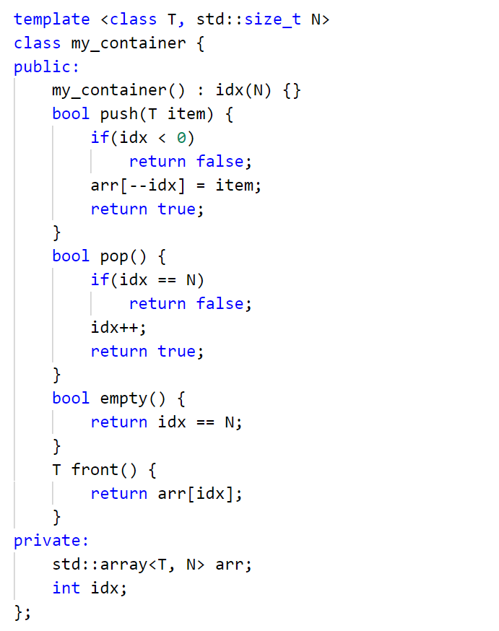
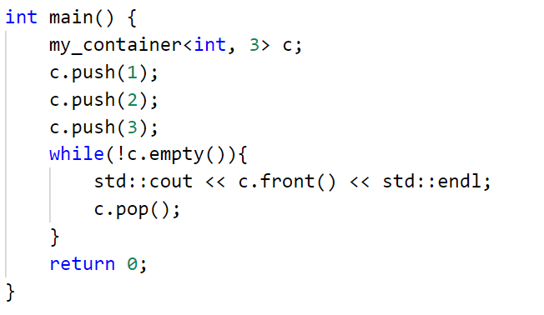

Slide 13
Practice! https://www.hackerrank.com/
Resources https://github.com/PanagiotisPtr/cpp_workshop

